Slide 1
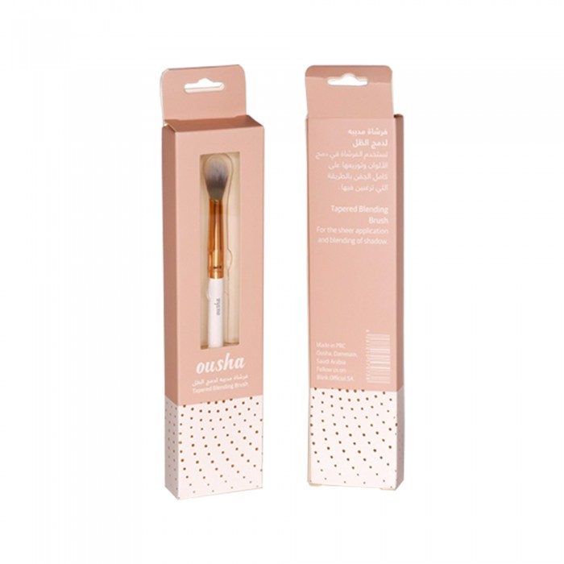
Osha
Usha pointed brush to combine colors
63.83 SAR. Q
Usha Pointy Brush to Fuse Shade use the brush to combine colors and distribute them over the whole eyelid in the way you wish.

Slide 2
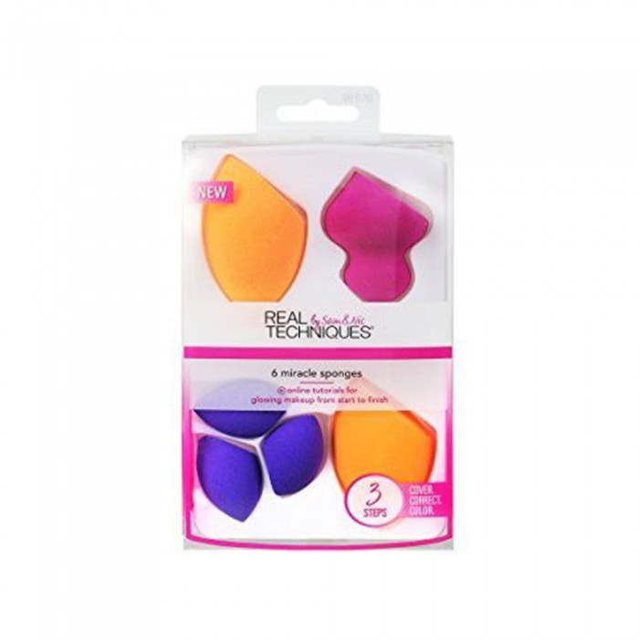
Reel Technics
Rail Technics 1570 Miracle Combex Sponges 6pcs
165.38 SAR Q
It contains:
- (2) sponge for coverage and integration: designed to create the perfect base
- (3) Small eraser sponges: These small sponges help to get rid of makeup errors using soft and flexible foam that helps to pick up any kind of makeup, especially around the eyes
- (1) Carving sponge to identify facial features: to help create shadows or highlight your favorite facial features

Slide 3
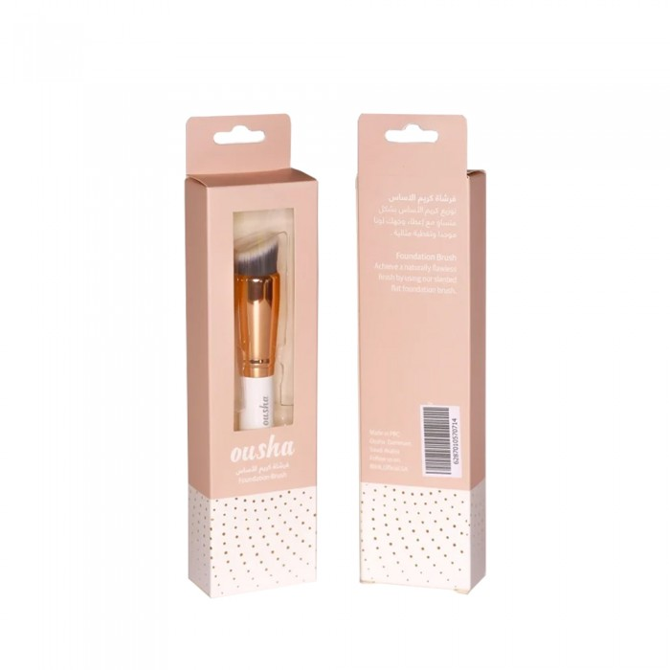
Osha
Usha Foundation Brush
77.05 SAR. Q
Foundation brush where you equally distribute the foundation giving your face a uniform color and perfect coverage.
Product Characteristics:
- Osha is one of Blink's products.
- Blink is the first Saudi brand of eyelashes.
- Blink offers a highly efficient product.
- Helps women to be more confident and beautiful.

Slide 4
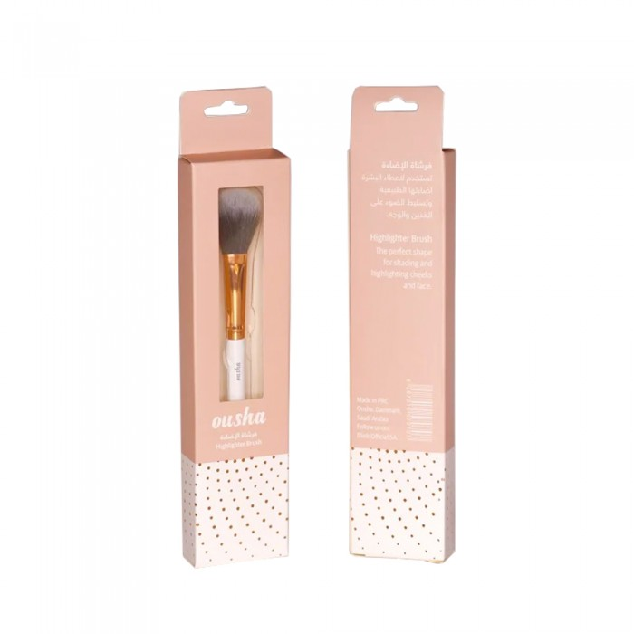
Osha
Usha Lighting Brush
66.13 SAR. Q
Usha light brush where it is used to give skin its natural brightness and highlight cheeks and face.

Slide 5
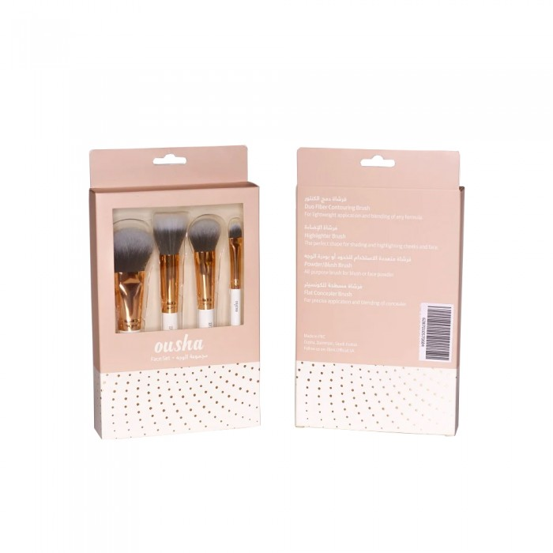
Osha
OSHA FACIAL BRUSHES SET
104.08 SAR. Q
OSHA Eye Brush Set consisting of four kinds of brushes, contour fusion brush, lighting brush, multi-use cheek brush or face powder, flat contour brush

Slide 6
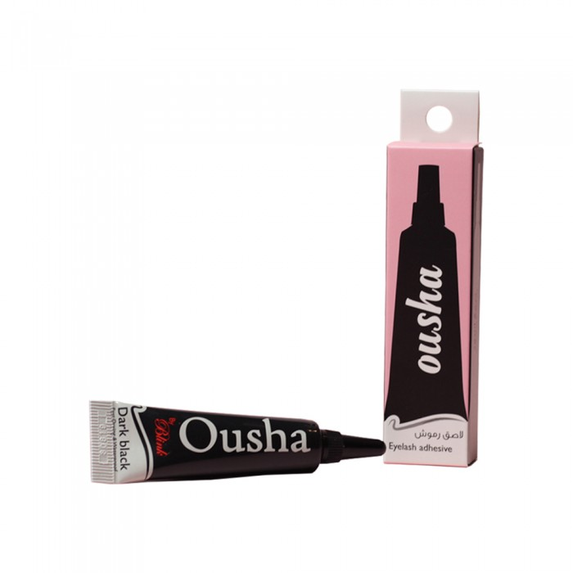
Osha
Osha Glue Black Eyelashes
46.00 SAR Q
Osha glue black eyelashes to achieve perfect eye makeup and simple long-lasting! This eyelash glue is safe to use as it helps to install artificial eyelashes and eyelash connections in the right place within moments!

Slide 7
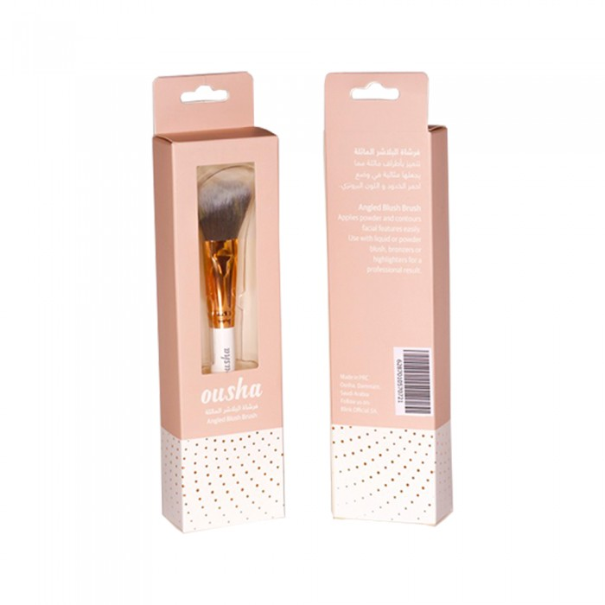
Osha
Usha Leaning Blush Brush
71.30 SAR Q
OSHA Blush Brush features slash limbs making it perfect in blush and bronze mode. Use it with liquid blush, powder or highlighter for professional result

